Slide 1
A Seminar on BullyNet: Unmasking Cyberbullies on Social Network
Team Details
E VASANTH RAO(20EG105616)
K LAHARI(20EG105620)
J VENUGOPAL(20EG105650)
Project Supervisor
Name – B V SRIKANTH
Designation

Slide 2
Introduction
"BullyNet Unmasking Cyberbullies on Social Networks" is a project aimed at developing a system to effectively identify and unmask individuals engaging in cyberbullying within social network platforms. The project involves leveraging a combination of data collection, machine learning, and network analysis techniques to detect patterns associated with cyberbullying behavior. To implement BullyNet, one would need programming languages such as Python, web scraping tools like BeautifulSoup or Scrapy, machine learning libraries such as Scikit-learn or TensorFlow, and network analysis tools like NetworkX.
The system would require access to relevant social media APIs for data retrieval and analysis. Applications of BullyNet extend to fostering a safer online environment by automatically identifying and exposing cyberbullies, thereby enabling timely intervention and prevention of harmful online behavior. This project aligns with the growing concern over online harassment and provides a technological solution to address the social challenges associated with cyberbullying on social networks.

Slide 3
Concept Tree
Social Network
Bully net Online Harassment Psychological Impact
Anonymity Reporting Mechanism Emotional Distress
Traceability of cyberbullies Manipulative Behaviour Mental Stress
Privacy and Concerns
CyberSecurity

Slide 4
Literature
Author(s) | Strategies | Advantages | Disadvantages
Aparna Sankaran Srinath, Hannah Johnson, Gaby G. Dagher, and Min Long | Conversation Graph Generation Algorithm. | Enhanced accuracy through A&M Centrality. | Potential unfamiliarity due to novel algorithms
Aparna Sankaran Srinath, Hannah Johnson, Gaby G. Dagher, and Min Long | Introduction of Attitude and Merit Centrality measure (A&M) | Improved detection through cyberbullying SN. | Dependence on optimal coefficient values
Aparna Sankaran Srinath, Hannah Johnson, Gaby G. Dagher, and Min Long | Bully Finding Algorithm with optimized coefficients | Efficient handling of large-scale datasets. | Possible challenges in scalability.

Slide 5
Problem Statement
The surge in cyberbullying on Twitter necessitates advanced detection methods. Current tools lack precision, especially in modeling behaviors within conversations, resulting in suboptimal identification accuracy.
The first method of determining bullying messages was done using a combination of text-based analytics and a mix of text and user features. Zhao et al. [18] proposed a text based Embeddings-Enhanced Bag-of-Words (EBoW) model that utilizes a concatenation of bullying features, bag-of-words, and latent semantic features to obtain a final representation, which is then passed through a classifier to identify cyberbullies.
Disadvantages
The system is less effective due to lack of Constructing bullying signed network.
The system doesn’t effective due to lack of training large scale datasets.
This project addresses these limitations by developing BullyNet, a three-phase algorithm. It aims to construct a cyberbullying signed network, analyze tweet contexts, and optimize centrality measures for improved accuracy, particularly in large-scale social media environments.

Slide 6
Problem Illustration
To address these issues, let's envision the proposed BullyNet method in action. Imagine the same scenario where a user encounter cyberbullying within a Twitter conversation. BullyNet, with its innovative Conversation Graph Generation Algorithm, constructs a detailed representation of the conversation dynamics. The Bullying Signed Network Generation Algorithm captures the essence of cyberbullying tendencies. The subsequent Bully Finding Algorithm, optimized for coefficients, enhances accuracy. However, the potential unfamiliarity and increased complexity of BullyNet may pose challenges. Despite this, the method's efficiency in handling large-scale datasets and improved detection capabilities make it a promising solution for combatting cyberbullying.

Slide 7
Example
Let's take a sample Twitter conversation involving three users: UserA, UserB, and UserC. In this scenario, UserA posts a tweet, and UserB responds positively, while UserC engages in cyberbullying behavior. Traditional algorithms may struggle to accurately identify the cyberbullying instance due to the subtleties in language and context.
UserA Tweet: "Excited about the weekend plans! 😊"
UserB Reply: "Sounds great! Have an amazing time! 🎉"
UserC Reply (Cyberbullying): "Your plans are so lame, nobody cares! 🙄“

Slide 8
Proposed Method
This para covers following :
To Solve above problem ,by which method and what are parameter(s) improved
The proposed system addresses the issue of cyberbullying on Twitter by examining tweet contexts or conversations. The key research question is whether analyzing the conversation surrounding a tweet improves cyberbullying detection. The system comprises three main components: Conversation Graph Generation, Bullying Signed Network creation, and the Attitude & Merit Centrality measure for identifying bullying users. The contributions include dataset collection and preprocessing.The system's advantages lie in its effectiveness, aided by specific algorithms for Conversation Graph and Bullying Signed Network generation, along with a robust approach for analyzing large datasets. The results demonstrate high accuracy in cyberbully detection while maintaining scalability

Slide 9
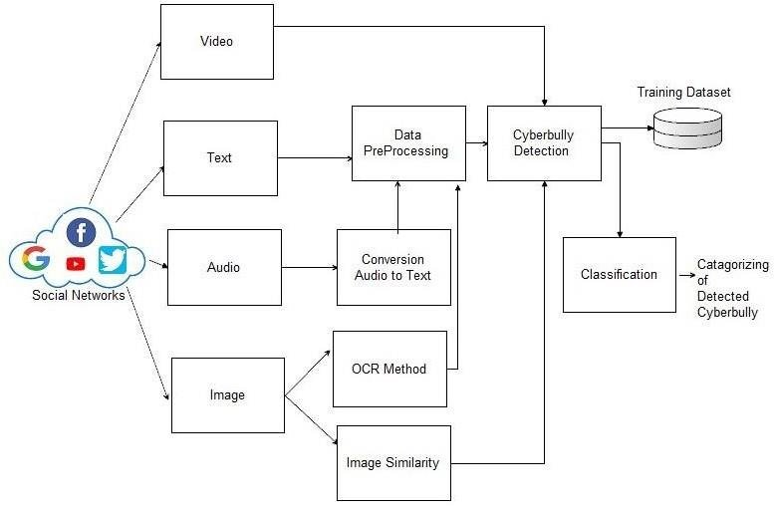
Proposed Method Illustration

Slide 10
Parameters
Text Cleaning:
No specific formula, but common text cleaning steps involve removing stop words, punctuation, and non-alphanumeric characters. Tokenization can be achieved using libraries like NLTK or spaCy in Python.
AccuracyCM:
The accuracy measure is the ratio of the number of bully users detected to the total number of bullies. It does not perform well with imbalanced data sets.
AccuracyCM = No of detected bullies / total number of bullies
Precision and Recall:
Precision and Recall are evaluation metrics used in binary classification tasks. Precision is the measure of exactness and recall is the measure of completeness.
Precision = No of true bullies detected / total number of detected users Recall = No of true bullies detected / total number of true bullies.
F1 Measure: F1 Measure is the Harmonic Mean between precision and recall. The range for F1 is [0, 1]. It measures how many bullies are identified correctly and how robust it is.
F1 = 2 × P recision × Recall P recision + Recall F1

Slide 11
Experiment Environment
Programming Languages:
Python: Widely used for data analysis, machine learning, and web scraping. Libraries like NumPy, Pandas, Scikit-learn, and TensorFlow can be beneficial.
Web Scraping:
Use libraries like BeautifulSoup or Scrapy for extracting data from social media websites.
Machine Learning:
Scikit-learn: For building and training machine learning models.
Network Analysis:
NetworkX: Useful for analyzing the structure of social networks.
Database:
SQLite or MySQL: For storing and managing collected data.
Web Development (if applicable):
Django or Flask: If you plan to develop a web-based interface for BullyNet.
Data Visualization:
Matplotlib or Seaborn: For creating visualizations of data.

Slide 12
Project status
S.No | Functionality | Status (Completed /in-progress/Not started)
1 | Data Collection | Completed
2 | Train Model | Completed
3 | Evaluation of model | Started
4 | Developing Web Application | Started

Slide 13
References
[1] J. Tang, C. Aggarwal, and H. Liu, “Recommendations in signed social networks,” in Proc. 25th Int. Conf. World Wide Web, Apr. 2016, pp. 31–40.
[2] Cyberbullying Research Center. https://cyberbullying.org/bullying-laws.
[3] X. Hu, J. Tang, H. Gao, and H. Liu, “Social spammer detection with sentiment information,” in Proc. IEEE Int. Conf. Data Mining, Dec. 2014, pp. 180–189.
[4] E. E. Buckels, P. D. Trapnell, and D. L. Paulhus, Trolls Just Want to Have Fun. Springer, 2014, pp. 67:97–102.
[5] S. Kumar, F. Spezzano, and V. S. Subrahmanian, “Accurately detecting trolls in slashdot zoo via decluttering,” in Proc. IEEE/ACM Int. Conf. Adv. Social Netw. Anal. Mining (ASONAM), Aug. 2014, pp. 188–195.
[6] Jiliang Tang, Charu Aggarwal, and Huan Liu. Node classification in signed social networks. In Proceedings of the SIAM ICDM, pages 54–62, 2016.

Slide 14
References
[7] Jiliang Tang, Charu Aggarwal, and Huan Liu. Recommendations in signed social networks. In Proceedings of the International Conference on WWW, pages 31–40, 2016.
[8] Vivek K. Singh, Qianjia Huang, and Pradeep K. Atrey. Cyberbullying detection using probabilistic socio-textual information fusion. In Proceedings of the IEEE/ACM ASONAM, pages 884–887, 2016.
[9] J. W. Patchin and S. Hinduja, “2016 cyberbullying data,” Cyberbullying Res. Center, Tech. Rep. 2016, 2017.
[10] Cyberbullying Research Center. State Bullying Laws in America. Accessed: Jul. 1, 2020. [Online]. available: https://cyberbullying. org/bullying-laws

Slide 15
Thank you

Slide 16
Project seminar–I Evaluation
S.No | Rubrics | Marks
1 | Concept Introduction | 4
2 | Literature and Parameter | 5
3 | Problem and Problem Illustration | 8
4 | Proposed Method and Illustration | 8
Total |  | 25

